Slide 1
OneTickQueries – What else ?

Slide 2
OneTickQueries – What else ?
Let’s have a quick look at the query training modules that we are NOT covering in today’s short introduction…

Slide 3
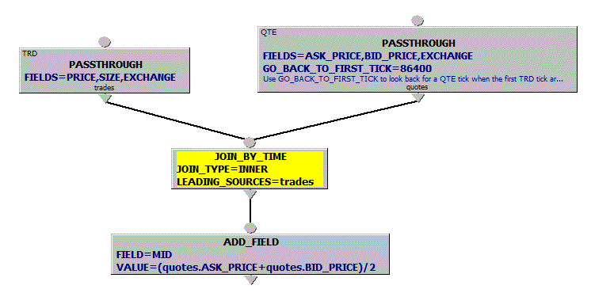
JOIN_BY_TIME (Module 3 )
Example:
Join
each trade
with the prevailing quote
A common usage is to look at the state of one data source (often a stream of quotes) each time an event is seen on another stream ( often a stream of trades)
To do this we set the event stream as the leading source.
If the join is INNER we will not see output for any trade events that happen before the first quote event, as these trades will not find a quote to join with.
If the join is OUTER we may see trades with no attached quote info.
Best solution may be to use OUTER but to have GO_BACK_TO_FIRST_TICK in the quote PASSTHROUGH.

Slide 4
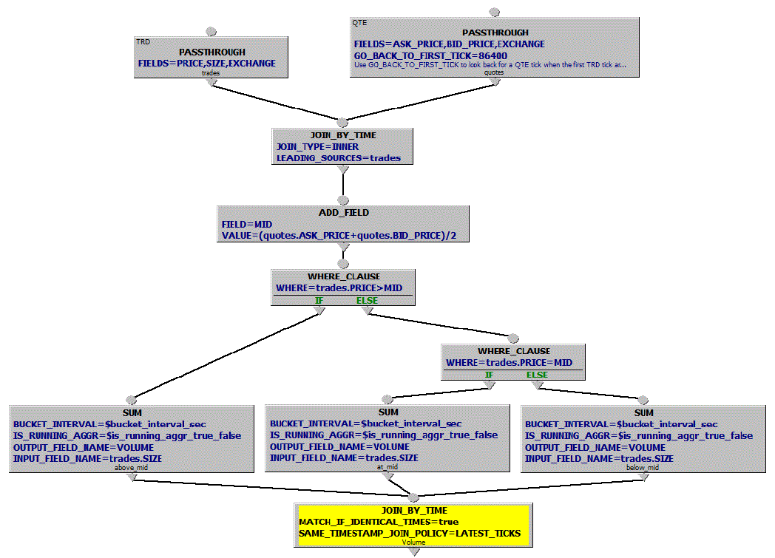
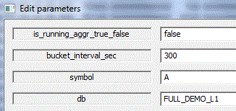
Example 1: Calculate volume of trades above, below and at MID for each 5 minute interval

Slide 5
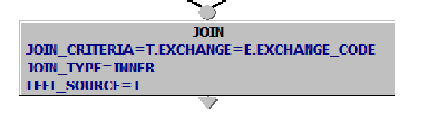
JOIN
A JOIN can specify a WHERE clause similar to what you have in a regular RDMS
Examples:
Join a single tick from one time series with a group of ticks from another time series. E.g., join an order to all of its executions. Or, to join an order to all of the trades executed while the order was being filled.
Join 2 time series for a pair of symbols to produce cross-symbol calculations (though there are other ways)

Slide 6
OneTick Training (Module 4)
Fields
State Variables
Nested Queries

Slide 7
Fields
Queries can add fields to a record for the duration of the query using the ADD_FIELDS EP using expressions containing:
Built-in functions
“Special” fields (_SYMBOL_NAME,_START_DATE…)
The value of a field on this tick, or a previous or future tick by using a negative/positive index. E.g. PRICE-PRICE[-1] or PRICE[+1]
Field values can be changed (including the TIMESTAMP field*) using the UPDATE_FIELDS EP. The WHERE parameter allows you to control when the changes will occur.
TIP * If you do change the TIMESTAMP field it must still have a value between _START_TIME and _END_TIME. UPDATE_TIMESTAMP EP provides more time-specific options – see Help for more details.

Slide 8
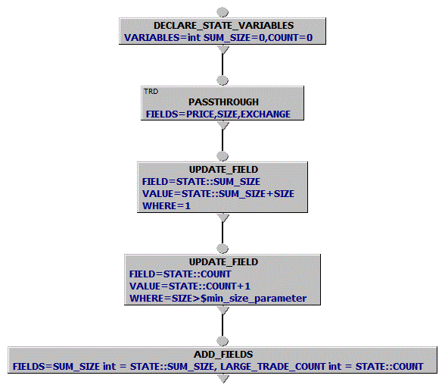

State Variables
Declare STATE vars
Retrieve Trades
Update values of STATE vars on each tick. Use WHERE as needed.
Output values of STATE vars as FIELDS
TIP - $[parameter_name] creates query parameters that can be re-used across the whole query.

Slide 9
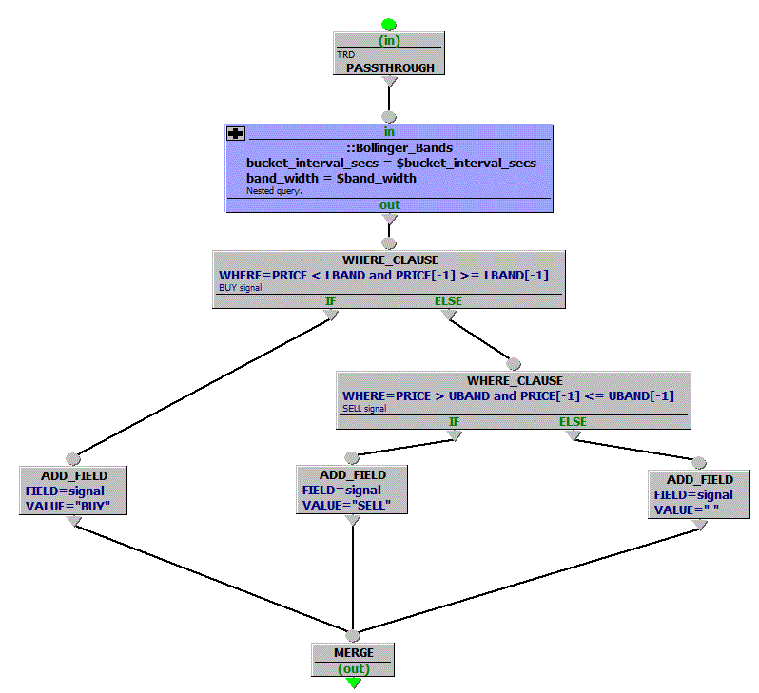
Nested Queries
Bollinger_Bands_Signals “parent” query. ::Bollinger_Bands is a nested query that can be shared across “parent” queries with different parameters. Its code can be maintained in the same or different OTQ file.
NOTE: This “parent” query can be further nested.

Slide 10
OneTick Training (Module 5)
Order Book EPs

Slide 11
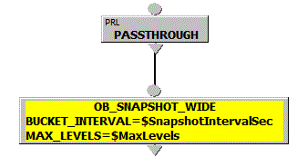
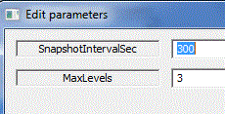
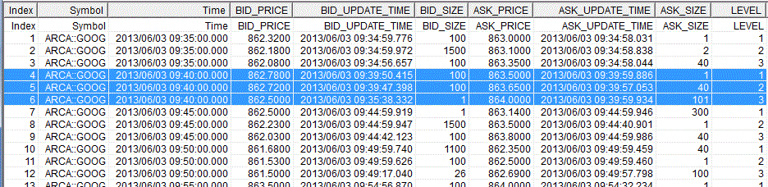
OB_SNAPSHOT_WIDE
OB_SNAPSHOT_WIDE outputs 1 line with ASK/BID values per interval per LEVEL

Slide 12
Input & Output (Module 9)
Updating an existing database “DB/” EPs.
Writing to a database.
Writing to or reading from a OneTick Raw file.
Writing to or reading from delimited text files.
Executing SQL over ODBC.
Getting data from a URL

Slide 13
Other training modules…
11 – OTQ Programming
12 – Expressions and functions
13 – Tick sets
14 – Per Tick Script
15 – Advanced Join and Merge
16 – Split Query Output
17 - Corrections and Reference Data

